Slide 1
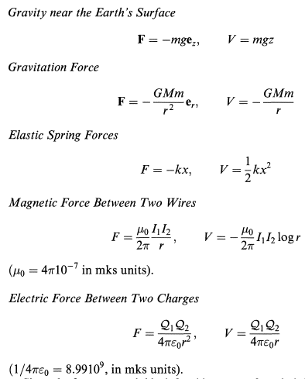


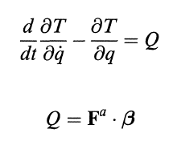





Method 1: Lagrange Equations
about the principal axis.
Rayleigh Dissipation Function for dissipative forces
Generalized non-conservative active forces
Projections vectors of the Jacobian

Slide 2
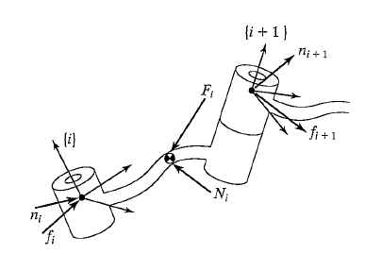
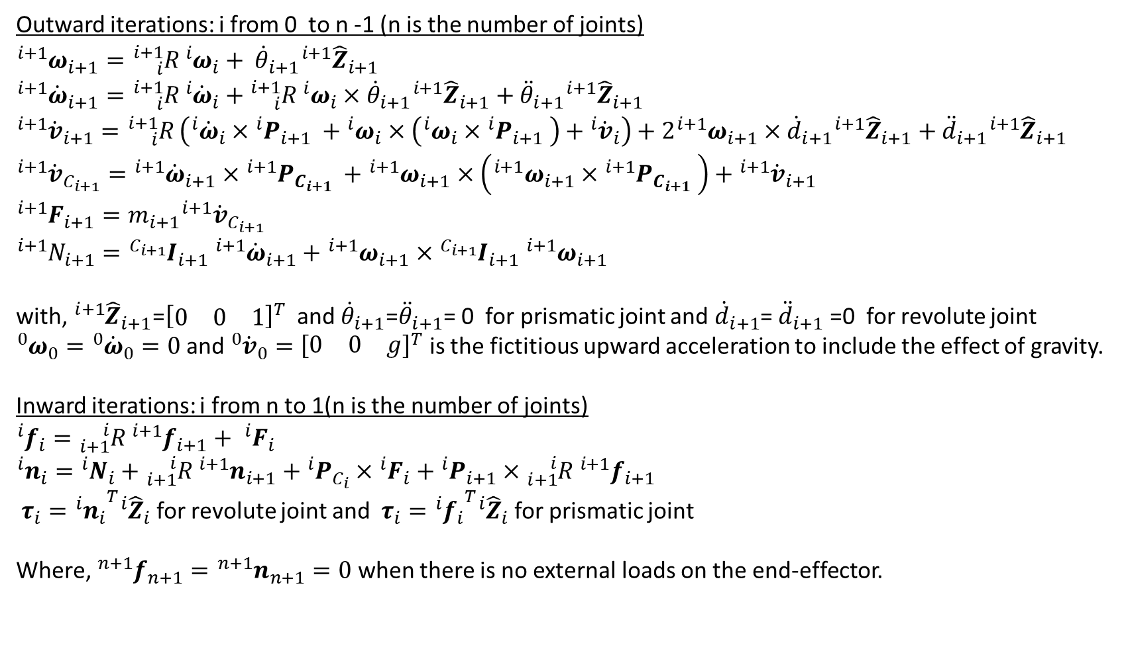
Method 2: Iterative Newton-Euler dynamic formulation
Outward iterations: i from 0 to n -1 (n is the number of joints)
${{}_{ }^{i+1}ω}_{i+1}={{}_{i}^{i+1}R}_{ }{{}_{ }^{i}ω}_{i}+ {\dot{θ}}_{i+1}{{}_{ }^{i+1}{\hat{Z}}}_{i+1}$
${{}_{ }^{i+1}{\dot{ω}}}_{i+1}={{}_{i}^{i+1}R}_{ }{{}_{ }^{i}{\dot{ω}}}_{i}+{{}_{i}^{i+1}R}_{ }{{}_{ }^{i}ω}_{i}×{\dot{θ}}_{i+1}{{}_{ }^{i+1}{\hat{Z}}}_{i+1}+{\ddot{θ}}_{i+1}{{}_{ }^{i+1}{\hat{Z}}}_{i+1}$
${{}_{ }^{i+1}{\dot{v}}}_{i+1}={{}_{i}^{i+1}R}_{ }\left({{}_{ }^{i}{\dot{ω}}}_{i}×{{{}_{ }^{i}P}_{i+1}}_{ }+{{}_{ }^{i}ω}_{i}×\left({{}_{ }^{i}ω}_{i}×{{{}_{ }^{i}P}_{i+1}}_{ }\right)+{{}_{ }^{i}{\dot{v}}}_{i}\right)+2{{}_{ }^{i+1}ω}_{i+1}×{\dot{d}}_{i+1}{{}_{ }^{i+1}{\hat{Z}}}_{i+1}+{\ddot{d}}_{i+1}{{}_{ }^{i+1}{\hat{Z}}}_{i+1}$
${{}_{ }^{i+1}{\dot{v}}}_{C_{i+1}}={{}_{ }^{i+1}{\dot{ω}}}_{i+1}×{{{}_{ }^{i+1}P}_{C_{i+1}}}_{ }+{{}_{ }^{i+1}ω}_{i+1}×\left({{}_{ }^{i+1}ω}_{i+1}×{{{}_{ }^{i+1}P}_{C_{i+1}}}_{ }\right)+{{}_{ }^{i+1}{\dot{v}}}_{i+1}$
${{}_{ }^{i+1}F}_{i+1}=m_{i+1}{{}_{ }^{i+1}{\dot{v}}}_{C_{i+1}}$
${{}_{ }^{i+1}N}_{i+1}={{{}_{ }^{C_{i+1}}I}_{i+1}}_{ }{{}_{ }^{i+1}{\dot{ω}}}_{i+1}+{{}_{ }^{i+1}ω}_{i+1}×{{{}_{ }^{C_{i+1}}I}_{i+1}}_{ }{{}_{ }^{i+1}ω}_{i+1}$
with,${{}_{ }^{i+1}{\hat{Z}}}_{i+1}$=${\left[\begin{matrix}0 & 0 & 1\end{matrix}\right]}^{T}$ and ${\dot{θ}}_{i+1}$=${\ddot{θ}}_{i+1}$= 0 for prismatic joint and ${\dot{d}}_{i+1}$= ${\ddot{d}}_{i+1}$ =0 for revolute joint
${{}_{ }^{0}ω}_{0}={{}_{ }^{0}{\dot{ω}}}_{0}=0$ and ${{}_{ }^{0}{\dot{v}}}_{0}={\left[\begin{matrix}0 & 0 & g\end{matrix}\right]}^{T}$ is the fictitious upward acceleration to include the effect of gravity.
Inward iterations: i from n to 1(n is the number of joints)
${{}_{ }^{i}f}_{i}={{}_{i+1}^{i}R}_{ }{{}_{ }^{i+1}f}_{i+1}+ {{}_{ }^{i}F}_{i}$
${{}_{ }^{i}n}_{i}={{}_{ }^{i}N}_{i}+{{}_{i+1}^{i}R}_{ }{{}_{ }^{i+1}n}_{i+1}+{{}_{ }^{i}P}_{C_{i}}×{{}_{ }^{i}F}_{i}+{{}_{ }^{i}P}_{i+1}×{{}_{i+1}^{i}R}_{ }{{}_{ }^{i+1}f}_{i+1}$
${{}_{ }^{ }τ}_{i}={{{}_{ }^{i}n}_{i}}^{T}{{}_{ }^{i}{\hat{Z}}}_{i}$ for revolute joint and ${{}_{ }^{ }τ}_{i}={{{}_{ }^{i}f}_{i}}^{T}{{}_{ }^{i}{\hat{Z}}}_{i}$ for prismatic joint
Where, ${{}_{ }^{n+1}f}_{n+1}={{}_{ }^{n+1}n}_{n+1}=0$ when there is no external loads on the end-effector.

Slide 3
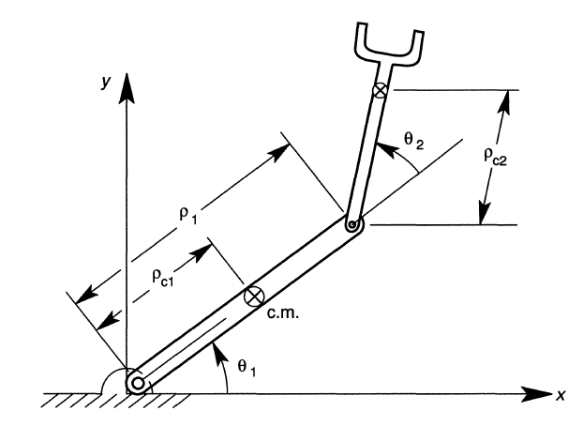
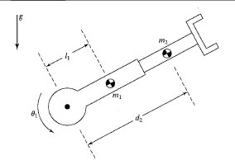


Problem 1: Using the Lagrange equation method find the equations of motion of the RR serial manipulator shown in the figure. (xy) is a vertical plane. Consider the links to be rigid rods.
$$ρ_{2}$$
L1
$$ρ_{1}$$

Slide 4
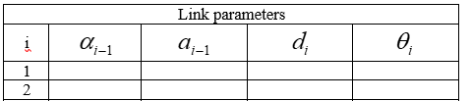
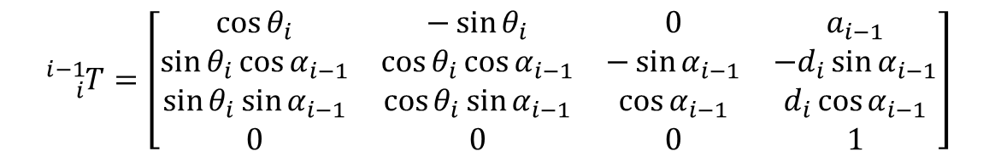

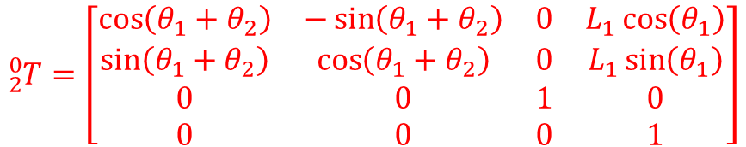



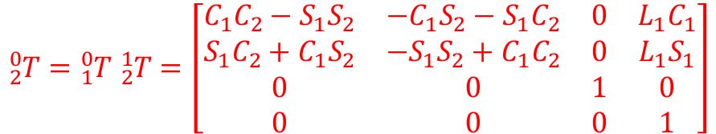




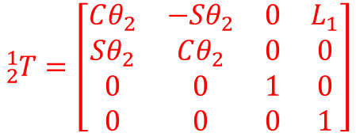

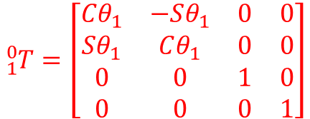






$$x_{2}$$
$$y_{2}$$
$$ρ_{2}$$
$$y_{1}$$
$$0$$
$$0$$
$$0$$
$$θ_{1}$$
L1
$$0$$
$$L_{1}$$
$$0$$
$$θ_{2}$$
$$ρ_{1}$$
$$x_{1}$$
$${}_{i}^{i−1}T=\left[\begin{matrix}\cos{θ_{i}} & −\sin{θ_{i}} & 0 & a_{i−1} \\ \sin{θ_{i}}\cos{α_{i−1}} & \cos{θ_{i}}\cos{α_{i−1}} & −\sin{α_{i−1}} & {−d}_{i}\sin{α_{i−1}} \\ \sin{θ_{i}}\sin{α_{i−1}} & \cos{θ_{i}}\sin{α_{i−1}} & \cos{α_{i−1}} & d_{i}\cos{α_{i−1}} \\ 0 & 0 & 0 & 1\end{matrix}\right]$$
$${}_{1}^{0}T=\left[\begin{matrix}{Cθ}_{1} & −Sθ_{1} & 0 & 0 \\ Sθ_{1} & Cθ_{1} & 0 & 0 \\ 0 & 0 & 1 & 0 \\ 0 & 0 & 0 & 1\end{matrix}\right]$$
$${}_{2}^{1}T=\left[\begin{matrix}Cθ_{2} & −Sθ_{2} & 0 & L_{1} \\ Sθ_{2} & Cθ_{2} & 0 & 0 \\ 0 & 0 & 1 & 0 \\ 0 & 0 & 0 & 1\end{matrix}\right]$$
$${}_{2}^{0}T={}_{1}^{0}T {}_{2}^{1}T=\left[\begin{matrix}C_{1}C_{2}−S_{1}S_{2} & −C_{1}S_{2}−S_{1}C_{2} & 0 & L_{1}C_{1} \\ S_{1}C_{2}+C_{1}S_{2} & {−S}_{1}S_{2}+C_{1}C_{2} & 0 & L_{1}S_{1} \\ 0 & 0 & 1 & 0 \\ 0 & 0 & 0 & 1\end{matrix}\right]$$
$${}_{2}^{0}T=\left[\begin{matrix}\cos\left(θ_{1}+θ_{2}\right) & −\sin\left(θ_{1}+θ_{2}\right) & 0 & L_{1}\cos\left(θ_{1}\right) \\ \sin\left(θ_{1}+θ_{2}\right) & \cos\left(θ_{1}+θ_{2}\right) & 0 & L_{1}\sin\left(θ_{1}\right) \\ 0 & 0 & 1 & 0 \\ 0 & 0 & 0 & 1\end{matrix}\right]$$
$C_{1}C_{2}−S_{1}S_{2}$ = $\cos\left(θ_{1}+θ_{2}\right)$
Since
$S_{1}C_{2}+C_{1}S_{2}$ = $\sin\left(θ_{1}+θ_{2}\right)$

Slide 5
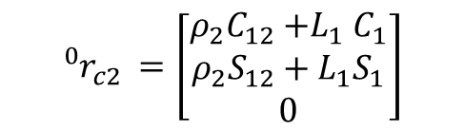
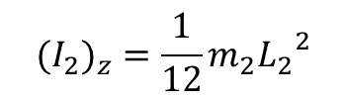
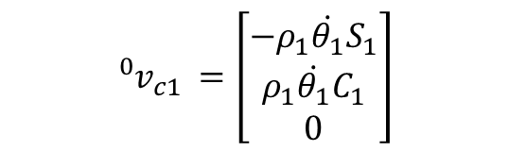
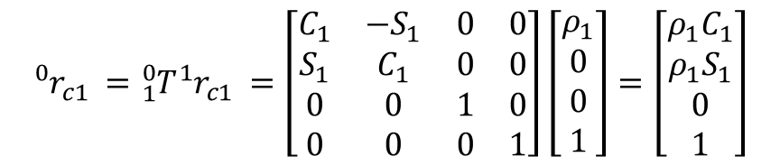
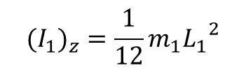
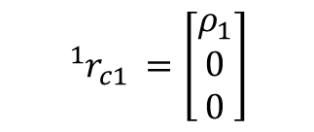
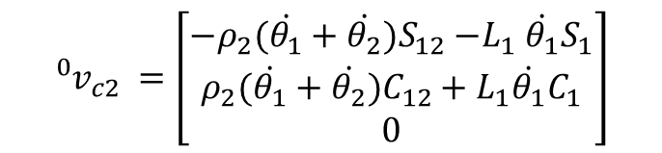
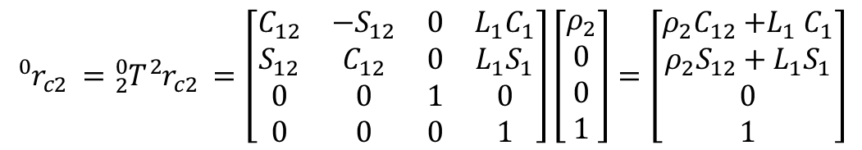
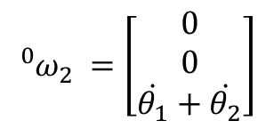
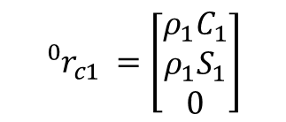
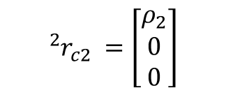
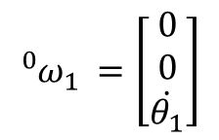
$$x_{2}$$
$${{}_{ }^{1}{r_{c1}}}^{ }=\left[\begin{matrix}ρ_{1} \\ 0 \\ 0\end{matrix}\right]$$
$${{}_{ }^{2}{r_{c2}}}^{ }=\left[\begin{matrix}ρ_{2} \\ 0 \\ 0\end{matrix}\right]$$
$$y_{2}$$
$$ρ_{2}$$
$${{}_{ }^{0}{r_{c1}}}^{ }={}_{1}^{0}T{{}_{ }^{1}{r_{c1}}}^{ }=\left[\begin{matrix}C_{1} & −S_{1} & 0 & 0 \\ S_{1} & C_{1} & 0 & 0 \\ 0 & 0 & 1 & 0 \\ 0 & 0 & 0 & 1\end{matrix}\right]\left[\begin{matrix}ρ_{1} \\ 0 \\ 0 \\ 1\end{matrix}\right]=\left[\begin{matrix}ρ_{1}C_{1} \\ ρ_{1}S_{1} \\ 0 \\ 1\end{matrix}\right]$$
$$y_{1}$$
L1
$$ρ_{1}$$
$$x_{1}$$
$${{}_{ }^{0}{r_{c2}}}^{ }={}_{2}^{0}T{{}_{ }^{2}{r_{c2}}}^{ }=\left[\begin{matrix}C_{12} & −S_{12} & 0 & L_{1}C_{1} \\ S_{12} & C_{12} & 0 & L_{1}S_{1} \\ 0 & 0 & 1 & 0 \\ 0 & 0 & 0 & 1\end{matrix}\right]\left[\begin{matrix}ρ_{2} \\ 0 \\ 0 \\ 1\end{matrix}\right]=\left[\begin{matrix}ρ_{2}C_{12}{+L}_{1}C_{1} \\ ρ_{2}S_{12}+L_{1}S_{1} \\ 0 \\ 1\end{matrix}\right]$$
$${{}_{ }^{0}{ω_{1}}}^{ }=\left[\begin{matrix}0 \\ 0 \\ \dot{θ_{1}}\end{matrix}\right]$$
$${{}_{ }^{0}{ω_{2}}}^{ }=\left[\begin{matrix}0 \\ 0 \\ \dot{θ_{1}}+\dot{θ_{2}}\end{matrix}\right]$$
$${{}_{ }^{0}{r_{c1}}}^{ }=\left[\begin{matrix}ρ_{1}C_{1} \\ ρ_{1}S_{1} \\ 0\end{matrix}\right]$$
$${{}_{ }^{0}{r_{c2}}}^{ }=\left[\begin{matrix}ρ_{2}C_{12}{+L}_{1}C_{1} \\ ρ_{2}S_{12}+L_{1}S_{1} \\ 0\end{matrix}\right]$$
For rigid rods $I_{z}=\frac{1}{12}mL^{2}$ on the center of mass.
$${{}_{ }^{0}{v_{c1}}}^{ }=\left[\begin{matrix}−ρ_{1}\dot{θ_{1}}S_{1} \\ ρ_{1}\dot{θ_{1}}C_{1} \\ 0\end{matrix}\right]$$
$${{}_{ }^{0}{v_{c2}}}^{ }=\left[\begin{matrix}−ρ_{2}(\dot{θ_{1}}+\dot{θ_{2}})S_{12}{−L}_{1}\dot{θ_{1}}S_{1} \\ ρ_{2}(\dot{θ_{1}}+\dot{θ_{2}})C_{12}+L_{1}\dot{θ_{1}}C_{1} \\ 0\end{matrix}\right]$$
$${{(I}_{1})}_{z}=\frac{1}{12}m_{1}{L_{1}}^{2}$$
$${{(I}_{2})}_{z}=\frac{1}{12}m_{2}{L_{2}}^{2}$$

Slide 6
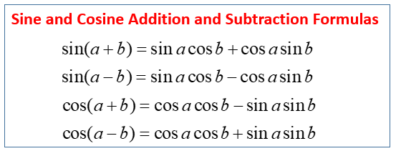
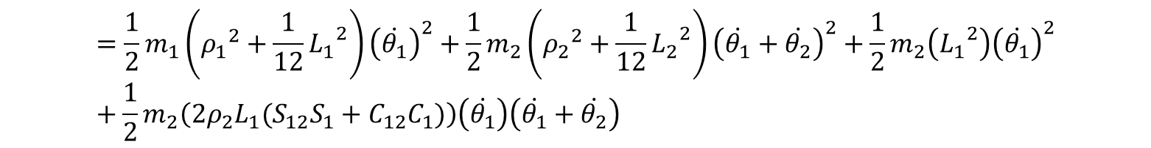

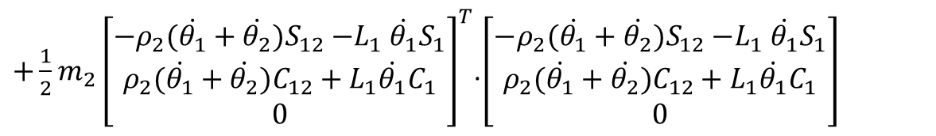
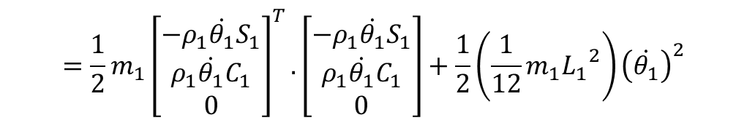
$$x_{2}$$
$T=T_{1}$ + $T_{2}=\frac{1}{2}m_{1}{}_{ }^{0}{v_{c1}}.{}_{ }^{0}{v_{c1}}+\frac{1}{2}{{(I}_{1})}_{z}{\left({({}_{ }^{0}{ω_{1}})}_{z}\right)}^{2}+\frac{1}{2}m_{2}{}_{ }^{0}{v_{c2}}$. ${}_{ }^{0}{v_{c2}}+\frac{1}{2}{{(I}_{2})}_{z}{\left({({}_{ }^{0}{ω_{2}})}_{z}\right)}^{2}$
$$=\frac{1}{2}m_{1}{\left[\begin{matrix}−ρ_{1}\dot{θ_{1}}S_{1} \\ ρ_{1}\dot{θ_{1}}C_{1} \\ 0\end{matrix}\right]}^{T}.\left[\begin{matrix}−ρ_{1}\dot{θ_{1}}S_{1} \\ ρ_{1}\dot{θ_{1}}C_{1} \\ 0\end{matrix}\right]+\frac{1}{2}\left(\frac{1}{12}m_{1}{L_{1}}^{2}\right){\left(\dot{θ_{1}}\right)}^{2}$$
$$y_{2}$$
$$ρ_{2}$$
$$y_{1}$$
L1
$+\frac{1}{2}m_{2}{\left[\begin{matrix}−ρ_{2}(\dot{θ_{1}}+\dot{θ_{2}})S_{12}{−L}_{1}\dot{θ_{1}}S_{1} \\ ρ_{2}(\dot{θ_{1}}+\dot{θ_{2}})C_{12}+L_{1}\dot{θ_{1}}C_{1} \\ 0\end{matrix}\right]}^{T}$.$\left[\begin{matrix}−ρ_{2}(\dot{θ_{1}}+\dot{θ_{2}})S_{12}{−L}_{1}\dot{θ_{1}}S_{1} \\ ρ_{2}(\dot{θ_{1}}+\dot{θ_{2}})C_{12}+L_{1}\dot{θ_{1}}C_{1} \\ 0\end{matrix}\right]$
$$ρ_{1}$$
$$x_{1}$$
$+\frac{1}{2}\left(\frac{1}{12}m_{2}{L_{2}}^{2}\right){\left(\dot{θ_{1}}+\dot{θ_{2}}\right)}^{2}$
$$=\frac{1}{2}m_{1}\left({ρ_{1}}^{2}+\frac{1}{12}{L_{1}}^{2}\right){\left(\dot{θ_{1}}\right)}^{2}+\frac{1}{2}m_{2}\left({ρ_{2}}^{2}+\frac{1}{12}{L_{2}}^{2}\right){\left(\dot{θ_{1}}+\dot{θ_{2}}\right)}^{2}+\frac{1}{2}m_{2}\left({L_{1}}^{2}\right){\left(\dot{θ_{1}}\right)}^{2}+\frac{1}{2}m_{2}\left(2ρ_{2}L_{1}(S_{12}S_{1}+C_{12}C_{1})\right)\left(\dot{θ_{1}}\right)\left(\dot{θ_{1}}+\dot{θ_{2}}\right)$$
$$=\frac{1}{2}m_{1}\left({ρ_{1}}^{2}+\frac{1}{12}{L_{1}}^{2}\right){\left(\dot{θ_{1}}\right)}^{2}+\frac{1}{2}m_{2}\left({ρ_{2}}^{2}+\frac{1}{12}{L_{2}}^{2}\right){\left(\dot{θ_{1}}+\dot{θ_{2}}\right)}^{2}+\frac{1}{2}m_{2}\left({L_{1}}^{2}\right){\left(\dot{θ_{1}}\right)}^{2}+\frac{1}{2}m_{2}\left(2ρ_{2}L_{1}C_{2}\right)\left(\dot{θ_{1}}\right)\left(\dot{θ_{1}}+\dot{θ_{2}}\right)$$

Slide 7
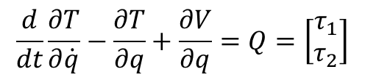
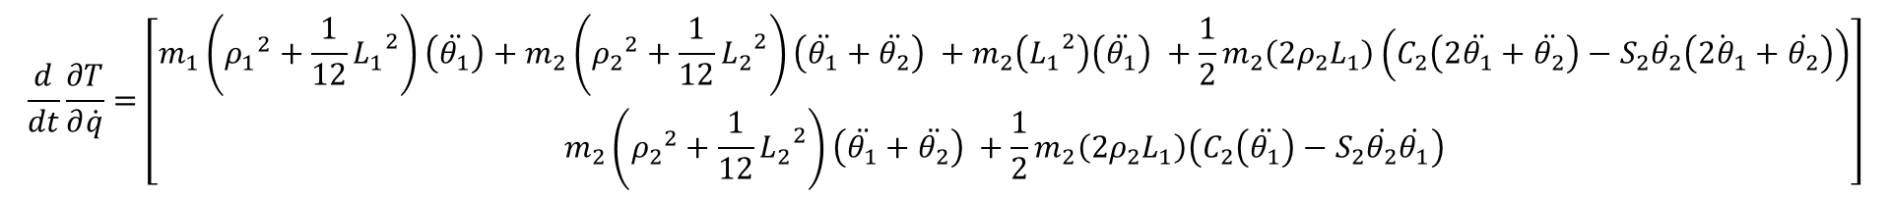
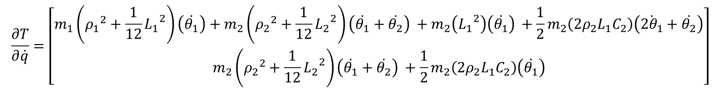


$$x_{2}$$
$V=V_{1}$ + $V_{2}=m_{1}g{({}_{ }^{0}{r_{c1}})}_{y}+m_{2}g{({}_{ }^{0}{r_{c2}})}_{y}$
$=m_{1}gρ_{1}S_{1}+m_{2}g(ρ_{2}S_{12}+L_{1}S_{1}$)
$$y_{2}$$
$$ρ_{2}$$
$$y_{1}$$
L1
There is not any dissipative or non-conservative forces,
$$ρ_{1}$$
$$x_{1}$$
$$\frac{d}{dt}\frac{∂T}{∂\dot{q}}−\frac{∂T}{∂q}+\frac{∂V}{∂q}=Q=\left[\begin{matrix}τ_{1} \\ τ_{2}\end{matrix}\right]$$
Where $τ_{1}$ and $τ_{2}$ are the torques on the joints motors.
$$\frac{∂T}{∂\dot{q}}=\left[\begin{matrix}m_{1}\left({ρ_{1}}^{2}+\frac{1}{12}{L_{1}}^{2}\right)\left(\dot{θ_{1}}\right)+m_{2}\left({ρ_{2}}^{2}+\frac{1}{12}{L_{2}}^{2}\right){\left(\dot{θ_{1}}+\dot{θ_{2}}\right)}^{ }+m_{2}\left({L_{1}}^{2}\right){\left(\dot{θ_{1}}\right)}^{ }+\frac{1}{2}m_{2}\left(2ρ_{2}L_{1}C_{2}\right)\left(\dot{2θ_{1}}+\dot{θ_{2}}\right) \\ m_{2}\left({ρ_{2}}^{2}+\frac{1}{12}{L_{2}}^{2}\right){\left(\dot{θ_{1}}+\dot{θ_{2}}\right)}^{ }+\frac{1}{2}m_{2}\left(2ρ_{2}L_{1}C_{2}\right)\left(\dot{θ_{1}}\right)\end{matrix}\right]$$
$$\frac{d}{dt}\frac{∂T}{∂\dot{q}}=\left[\begin{matrix}m_{1}\left({ρ_{1}}^{2}+\frac{1}{12}{L_{1}}^{2}\right)\left(\ddot{θ_{1}}\right)+m_{2}\left({ρ_{2}}^{2}+\frac{1}{12}{L_{2}}^{2}\right){\left(\ddot{θ_{1}}+\ddot{θ_{2}}\right)}^{ }+m_{2}\left({L_{1}}^{2}\right){\left(\ddot{θ_{1}}\right)}^{ }+\frac{1}{2}m_{2}\left(2ρ_{2}L_{1}\right)\left(C_{2}\left(2\ddot{θ_{1}}+\ddot{θ_{2}}\right)−S_{2}\dot{θ_{2}}\left(\dot{2θ_{1}}+\dot{θ_{2}}\right)\right) \\ m_{2}\left({ρ_{2}}^{2}+\frac{1}{12}{L_{2}}^{2}\right){\left(\ddot{θ_{1}}+\ddot{θ_{2}}\right)}^{ }+\frac{1}{2}m_{2}\left(2ρ_{2}L_{1}\right)\left(C_{2}\left(\ddot{θ_{1}}\right)−S_{2}\dot{θ_{2}}\dot{θ_{1}}\right)\end{matrix}\right]$$

Slide 8
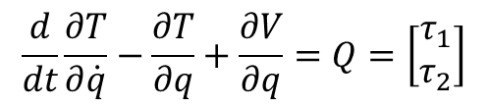
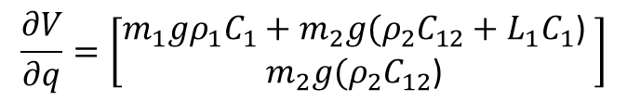
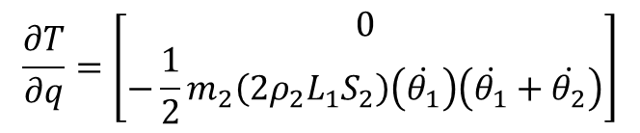
$$x_{2}$$
$$\frac{∂T}{∂q}=\left[\begin{matrix}0 \\ −\frac{1}{2}m_{2}\left(2ρ_{2}L_{1}S_{2}\right)\left(\dot{θ_{1}}\right)\left(\dot{θ_{1}}+\dot{θ_{2}}\right)\end{matrix}\right]$$
$$y_{2}$$
$$ρ_{2}$$
$$y_{1}$$
L1
$$\frac{∂V}{∂q}=\left[\begin{matrix}m_{1}gρ_{1}C_{1}+m_{2}g(ρ_{2}C_{12}+L_{1}C_{1}\text{)} \\ m_{2}g(ρ_{2}C_{12}\text{)} \end{matrix}\right]$$
$$ρ_{1}$$
$$x_{1}$$
$$\frac{d}{dt}\frac{∂T}{∂\dot{q}}−\frac{∂T}{∂q}+\frac{∂V}{∂q}=Q=\left[\begin{matrix}τ_{1} \\ τ_{2}\end{matrix}\right]$$
$$\left[\begin{matrix}m_{1}\left({ρ_{1}}^{2}+\frac{1}{12}{L_{1}}^{2}\right)\left(\ddot{θ_{1}}\right)+m_{2}\left({ρ_{2}}^{2}+\frac{1}{12}{L_{2}}^{2}\right){\left(\ddot{θ_{1}}+\ddot{θ_{2}}\right)}^{ }+m_{2}\left({L_{1}}^{2}\right){\left(\ddot{θ_{1}}\right)}^{ }+\frac{1}{2}m_{2}\left(2ρ_{2}L_{1}\right)\left(C_{2}\left(2\ddot{θ_{1}}+\ddot{θ_{2}}\right)−S_{2}\dot{θ_{2}}\left(\dot{2θ_{1}}+\dot{θ_{2}}\right)\right)+m_{1}gρ_{1}C_{1}+m_{2}g(ρ_{2}C_{12}+L_{1}C_{1}\text{)} \\ m_{2}\left({ρ_{2}}^{2}+\frac{1}{12}{L_{2}}^{2}\right){\left(\ddot{θ_{1}}+\ddot{θ_{2}}\right)}^{ }+\frac{1}{2}m_{2}\left(2ρ_{2}L_{1}\right)\left(C_{2}\left(\ddot{θ_{1}}\right)−S_{2}\dot{θ_{2}}\dot{θ_{1}}\right)+\frac{1}{2}m_{2}\left(2ρ_{2}L_{1}S_{2}\right)\left(\dot{θ_{1}}\right)\left(\dot{θ_{1}}+\dot{θ_{2}}\right)+m_{2}g(ρ_{2}C_{12}\text{)}\end{matrix}\right]=\left[\begin{matrix}τ_{1} \\ τ_{2}\end{matrix}\right]$$
$$\left[\begin{matrix}m_{1}\left({ρ_{1}}^{2}+\frac{1}{12}{L_{1}}^{2}\right)\left(\ddot{θ_{1}}\right)+m_{2}\left({ρ_{2}}^{2}+\frac{1}{12}{L_{2}}^{2}\right){\left(\ddot{θ_{1}}+\ddot{θ_{2}}\right)}^{ }+m_{2}\left({L_{1}}^{2}\right){\left(\ddot{θ_{1}}\right)}^{ }+\frac{1}{2}m_{2}\left(2ρ_{2}L_{1}\right)\left(C_{2}\left(2\ddot{θ_{1}}+\ddot{θ_{2}}\right)−S_{2}\dot{θ_{2}}\left(\dot{2θ_{1}}+\dot{θ_{2}}\right)\right)+m_{1}gρ_{1}C_{1}+m_{2}g(ρ_{2}C_{12}+L_{1}C_{1}\text{)} \\ m_{2}\left({ρ_{2}}^{2}+\frac{1}{12}{L_{2}}^{2}\right){\left(\ddot{θ_{1}}+\ddot{θ_{2}}\right)}^{ }+\frac{1}{2}m_{2}\left(2ρ_{2}L_{1}\right)\left(C_{2}\left(\ddot{θ_{1}}\right)\right)+\frac{1}{2}m_{2}\left(2ρ_{2}L_{1}S_{2}\right)\left({\dot{θ_{1}}}^{2}\right)+m_{2}g(ρ_{2}C_{12}\text{)}\end{matrix}\right]=\left[\begin{matrix}τ_{1} \\ τ_{2}\end{matrix}\right]$$

Slide 9
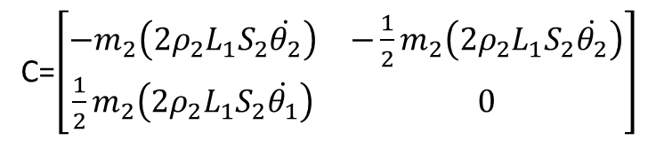

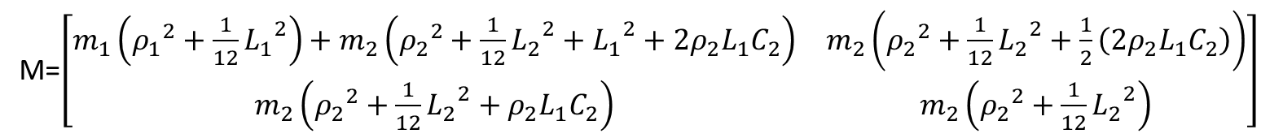
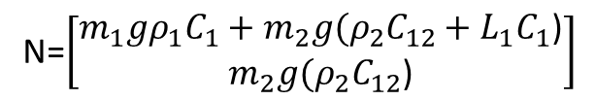


$$M\left(θ\right)\ddot{θ}+C\left(θ,\dot{θ}\right)\dot{θ}+N(θ,\dot{θ}) =τ$$
Where $M$ is the mass and inertia matrix, C is the Coriolis and centrifugal matrix and N is the stiffness matrix.
$$\left[\begin{matrix}m_{1}\left({ρ_{1}}^{2}+\frac{1}{12}{L_{1}}^{2}\right)+m_{2}\left({ρ_{2}}^{2}+\frac{1}{12}{L_{2}}^{2}+{L_{1}}^{2}+2ρ_{2}L_{1}C_{2}\right) & m_{2}\left({ρ_{2}}^{2}+\frac{1}{12}{L_{2}}^{2}+\frac{1}{2}\left(2ρ_{2}L_{1}C_{2}\right)\right) \\ m_{2}\left({ρ_{2}}^{2}+\frac{1}{12}{L_{2}}^{2}+ρ_{2}L_{1}C_{2}\right) & m_{2}\left({ρ_{2}}^{2}+\frac{1}{12}{L_{2}}^{2}\right)\end{matrix}\right]\left[\begin{matrix}{\ddot{θ}}_{1} \\ {\ddot{θ}}_{2}\end{matrix}\right]+\left[\begin{matrix}−m_{2}\left(2ρ_{2}L_{1}S_{2}\dot{θ_{2}}\right) & −{\frac{1}{2}m}_{2}\left(2ρ_{2}L_{1}S_{2}\dot{θ_{2}}\right) \\ \frac{1}{2}m_{2}\left(2ρ_{2}L_{1}S_{2}\dot{θ_{1}}\right) & 0\end{matrix}\right]\left[\begin{matrix}\dot{θ_{1}} \\ \dot{θ_{2}}\end{matrix}\right]+\left[\begin{matrix}m_{1}gρ_{1}C_{1}+m_{2}g(ρ_{2}C_{12}+L_{1}C_{1}\text{)} \\ m_{2}g(ρ_{2}C_{12}\text{)}\end{matrix}\right]=\left[\begin{matrix}τ_{1} \\ τ_{2}\end{matrix}\right]$$
M=$\left[\begin{matrix}m_{1}\left({ρ_{1}}^{2}+\frac{1}{12}{L_{1}}^{2}\right)+m_{2}\left({ρ_{2}}^{2}+\frac{1}{12}{L_{2}}^{2}+{L_{1}}^{2}+2ρ_{2}L_{1}C_{2}\right) & m_{2}\left({ρ_{2}}^{2}+\frac{1}{12}{L_{2}}^{2}+\frac{1}{2}\left(2ρ_{2}L_{1}C_{2}\right)\right) \\ m_{2}\left({ρ_{2}}^{2}+\frac{1}{12}{L_{2}}^{2}+ρ_{2}L_{1}C_{2}\right) & m_{2}\left({ρ_{2}}^{2}+\frac{1}{12}{L_{2}}^{2}\right)\end{matrix}\right]$
C=$\left[\begin{matrix}−m_{2}\left(2ρ_{2}L_{1}S_{2}\dot{θ_{2}}\right) & −{\frac{1}{2}m}_{2}\left(2ρ_{2}L_{1}S_{2}\dot{θ_{2}}\right) \\ \frac{1}{2}m_{2}\left(2ρ_{2}L_{1}S_{2}\dot{θ_{1}}\right) & 0\end{matrix}\right]$
$$x_{2}$$
$$y_{2}$$
$$ρ_{2}$$
N=$\left[\begin{matrix}m_{1}gρ_{1}C_{1}+m_{2}g(ρ_{2}C_{12}+L_{1}C_{1}\text{)} \\ m_{2}g(ρ_{2}C_{12}\text{)}\end{matrix}\right]$
$$y_{1}$$
L1
$$ρ_{1}$$
$$x_{1}$$

Slide 10
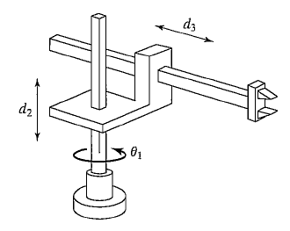
Problem 2: Using the Iterative Newton-Euler dynamic formulation method find the equations of motion of the RPP serial manipulator shown in the figure.

Slide 11
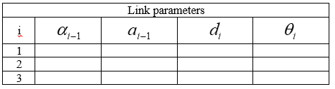




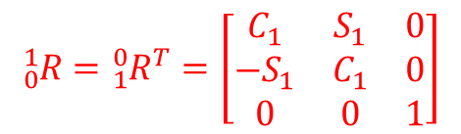

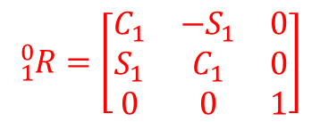
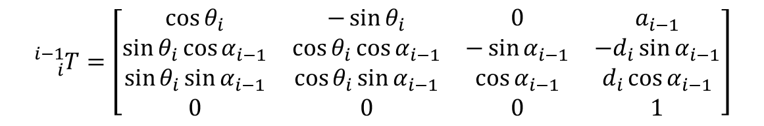

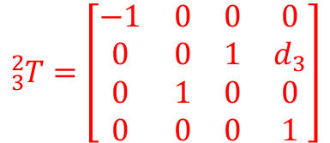





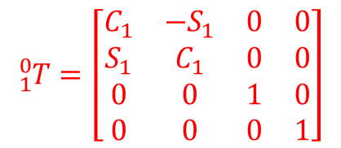





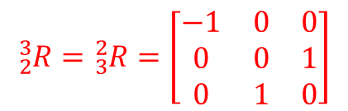









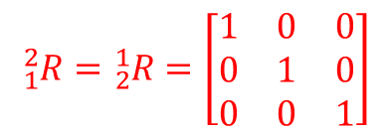
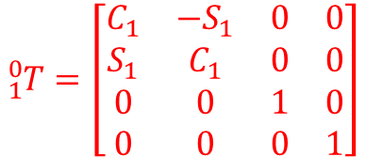

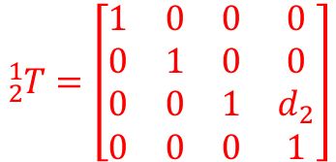






$$z_{2}$$
$$y_{3}$$
$$x_{3}$$
$$0$$
$$0$$
$$0$$
$$θ_{1}$$
$$0$$
$$0$$
$$d_{2}$$
$$0$$
$$C_{2}$$
$$C_{3}$$
$$0$$
$$d_{3}$$
18$0$
$$z_{3}$$
$$−90$$
$${}_{i}^{i−1}T=\left[\begin{matrix}\cos{θ_{i}} & −\sin{θ_{i}} & 0 & a_{i−1} \\ \sin{θ_{i}}\cos{α_{i−1}} & \cos{θ_{i}}\cos{α_{i−1}} & −\sin{α_{i−1}} & {−d}_{i}\sin{α_{i−1}} \\ \sin{θ_{i}}\sin{α_{i−1}} & \cos{θ_{i}}\sin{α_{i−1}} & \cos{α_{i−1}} & d_{i}\cos{α_{i−1}} \\ 0 & 0 & 0 & 1\end{matrix}\right]$$
$$y_{2}$$
$$x_{2}$$
$$z_{0},z_{1}$$
$$C_{1}$$
$${}_{1}^{0}T=\left[\begin{matrix}C_{1} & −S_{1} & 0 & 0 \\ S_{1} & C_{1} & 0 & 0 \\ 0 & 0 & 1 & 0 \\ 0 & 0 & 0 & 1\end{matrix}\right]$$
$${}_{2}^{1}T=\left[\begin{matrix}1 & 0 & 0 & 0 \\ 0 & 1 & 0 & 0 \\ 0 & 0 & 1 & d_{2} \\ 0 & 0 & 0 & 1\end{matrix}\right]$$
$${}_{3}^{2}T=\left[\begin{matrix}−1 & 0 & 0 & 0 \\ 0 & 0 & 1 & d_{3} \\ 0 & 1 & 0 & 0 \\ 0 & 0 & 0 & 1\end{matrix}\right]$$
$$y_{0},y_{1}$$
$$x_{0},x_{1}$$
$${}_{1}^{0}R$$
$${{}_{ }^{0}P}_{1}$$
$${}_{1}^{0}T=\left[\begin{matrix}C_{1} & −S_{1} & 0 & 0 \\ S_{1} & C_{1} & 0 & 0 \\ 0 & 0 & 1 & 0 \\ 0 & 0 & 0 & 1\end{matrix}\right]$$
$${}_{0}^{1}R={{}_{1}^{0}R}^{T}=\left[\begin{matrix}C_{1} & S_{1} & 0 \\ {−S}_{1} & C_{1} & 0 \\ 0 & 0 & 1\end{matrix}\right]$$
$${}_{1}^{2}{R={}_{2}^{1}R}=\left[\begin{matrix}1 & 0 & 0 \\ 0 & 1 & 0 \\ 0 & 0 & 1\end{matrix}\right]$$
$${}_{2}^{3}R={}_{3}^{2}R=\left[\begin{matrix}−1 & 0 & 0 \\ 0 & 0 & 1 \\ 0 & 1 & 0\end{matrix}\right]$$
$${}_{1}^{0}R=\left[\begin{matrix}C_{1} & {−S}_{1} & 0 \\ S_{1} & C_{1} & 0 \\ 0 & 0 & 1\end{matrix}\right]$$
$${{{}_{ }^{0}P}_{1}={\left[\begin{matrix}0 & 0 & 0\end{matrix}\right]}^{T}}_{ }$$
$${{{}_{ }^{1}P}_{2}={\left[\begin{matrix}0 & 0 & d_{2}\end{matrix}\right]}^{T}}_{ }$$
$${{{}_{ }^{2}P}_{3}={\left[\begin{matrix}0 & d_{3} & 0\end{matrix}\right]}^{T}}_{ }$$
$${{{}_{ }^{1}P}_{C_{1}}={\left[\begin{matrix}0 & 0 & 0\end{matrix}\right]}^{T}}_{ }$$
$${{{}_{ }^{2}P}_{C_{2}}={\left[\begin{matrix}0 & 0 & 0\end{matrix}\right]}^{T}}_{ }$$
$${{{}_{ }^{3}P}_{C_{3}}={\left[\begin{matrix}0 & 0 & 0\end{matrix}\right]}^{T}}_{ }$$

Slide 12
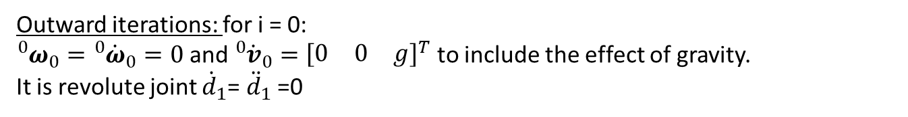

Outward iterations: for i = 0:
${{}_{ }^{0}ω}_{0}={{}_{ }^{0}{\dot{ω}}}_{0}=0$ and ${{}_{ }^{0}{\dot{v}}}_{0}={\left[\begin{matrix}0 & 0 & g\end{matrix}\right]}^{T}$ to include the effect of gravity.
It is revolute joint ${\dot{d}}_{1}$= ${\ddot{d}}_{1}$ =0
${{}_{ }^{1}ω}_{1}={{}_{0}^{1}R}_{ }{{}_{ }^{0}ω}_{0}+ {\dot{θ}}_{1}{{}_{ }^{1}{\hat{Z}}}_{1}={}_{0}^{1}R 0+{\dot{θ}}_{1}{\left[\begin{matrix}0 & 0 & 1\end{matrix}\right]}^{T}={\left[\begin{matrix}0 & 0 & {\dot{θ}}_{1}\end{matrix}\right]}^{T}$
${{}_{ }^{1}{\dot{ω}}}_{1}={{}_{0}^{1}R}_{ }{{}_{ }^{0}{\dot{ω}}}_{0}+{{}_{0}^{1}R}_{ }{{}_{ }^{0}ω}_{0}×{\dot{θ}}_{1}{{}_{ }^{1}{\hat{Z}}}_{1}+{\ddot{θ}}_{1}{{}_{ }^{1}{\hat{Z}}}_{1}={{}_{0}^{1}R}_{ }0+{{}_{0}^{1}R}_{ }0×{\dot{θ}}_{1}{\left[\begin{matrix}0 & 0 & 1\end{matrix}\right]}^{T}+{\ddot{θ}}_{1}{\left[\begin{matrix}0 & 0 & 1\end{matrix}\right]}^{T}={\left[\begin{matrix}0 & 0 & {\ddot{θ}}_{1}\end{matrix}\right]}^{T}$
${{}_{ }^{1}{\dot{v}}}_{1}={{}_{0}^{1}R}_{ }\left({{}_{ }^{0}{\dot{ω}}}_{0}×{{{}_{ }^{0}P}_{1}}_{ }+{{}_{ }^{0}ω}_{0}×\left({{}_{ }^{0}ω}_{0}×{{{}_{ }^{0}P}_{1}}_{ }\right)+{{}_{ }^{0}{\dot{v}}}_{0}\right)+2{{}_{ }^{1}ω}_{1}×{\dot{d}}_{1}{{}_{ }^{1}{\hat{Z}}}_{1}+{\ddot{d}}_{1}{{}_{ }^{1}{\hat{Z}}}_{1}$
$$={{}_{0}^{1}R}_{ }\left(0×{{\left[\begin{matrix}0 & 0 & 0\end{matrix}\right]}^{T}}_{ }+0×\left(0×{{\left[\begin{matrix}0 & 0 & 0\end{matrix}\right]}^{T}}_{ }\right)+{\left[\begin{matrix}0 & 0 & g\end{matrix}\right]}^{T}\right)+2{\left[\begin{matrix}0 & 0 & {\dot{θ}}_{1}\end{matrix}\right]}^{T}×0{\left[\begin{matrix}0 & 0 & 1\end{matrix}\right]}^{T}+0{\left[\begin{matrix}0 & 0 & 1\end{matrix}\right]}^{T}$$
$={\left[\begin{matrix}C_{1} & S_{1} & 0 \\ {−S}_{1} & C_{1} & 0 \\ 0 & 0 & 1\end{matrix}\right]\left[\begin{matrix}0 \\ 0 \\ g\end{matrix}\right]}_{ }=\left[\begin{matrix}0 \\ 0 \\ g\end{matrix}\right]$
${{}_{ }^{1}{\dot{v}}}_{C_{1}}={{}_{ }^{1}{\dot{ω}}}_{1}×{{{}_{ }^{1}P}_{C_{1}}}_{ }+{{}_{ }^{1}ω}_{1}×\left({{}_{ }^{1}ω}_{1}×{{{}_{ }^{1}P}_{C_{1}}}_{ }\right)+{{}_{ }^{1}{\dot{v}}}_{1}=\left[\begin{matrix}0 \\ 0 \\ {\ddot{θ}}_{1}\end{matrix}\right]×{\left[\begin{matrix}0 \\ 0 \\ 0\end{matrix}\right]}_{ }+\left[\begin{matrix}0 \\ 0 \\ {\dot{θ}}_{1}\end{matrix}\right]×\left(\left[\begin{matrix}0 \\ 0 \\ {\dot{θ}}_{1}\end{matrix}\right]×{\left[\begin{matrix}0 \\ 0 \\ 0\end{matrix}\right]}_{ }\right)+\left[\begin{matrix}0 \\ 0 \\ g\end{matrix}\right]=\left[\begin{matrix}0 \\ 0 \\ g\end{matrix}\right]$
${{}_{ }^{1}F}_{1}=m_{1}{{}_{ }^{1}{\dot{v}}}_{C_{1}}=m_{1}{\left[\begin{matrix}0 & 0 & g\end{matrix}\right]}^{T}={\left[\begin{matrix}0 & 0 & m_{1}g\end{matrix}\right]}^{T}$
$${{}_{ }^{1}N}_{1}={{{}_{ }^{C_{1}}I}_{1}}_{ }{{}_{ }^{1}{\dot{ω}}}_{1}+{{}_{ }^{1}ω}_{1}×{{{}_{ }^{C_{1}}I}_{1}}_{ }{{}_{ }^{1}ω}_{1}=\left[\begin{matrix}{\left({{}_{ }^{C_{1}}I}_{1}\right)}_{xx} & 0 & 0 \\ 0 & {\left({{}_{ }^{C_{1}}I}_{1}\right)}_{yy} & 0 \\ 0 & 0 & {\left({{}_{ }^{C_{1}}I}_{1}\right)}_{zz}\end{matrix}\right]\left[\begin{matrix}0 \\ 0 \\ {\ddot{θ}}_{1}\end{matrix}\right]+\left[\begin{matrix}0 \\ 0 \\ {\dot{θ}}_{1}\end{matrix}\right]×\left[\begin{matrix}{\left({{}_{ }^{C_{1}}I}_{1}\right)}_{xx} & 0 & 0 \\ 0 & {\left({{}_{ }^{C_{1}}I}_{1}\right)}_{yy} & 0 \\ 0 & 0 & {\left({{}_{ }^{C_{1}}I}_{1}\right)}_{zz}\end{matrix}\right]\left[\begin{matrix}0 \\ 0 \\ {\dot{θ}}_{1}\end{matrix}\right]$$
$={\left[\begin{matrix}0 & 0 & {\left({{}_{ }^{C_{1}}I}_{1}\right)}_{zz}{\ddot{θ}}_{1}\end{matrix}\right]}^{T}+{\left[\begin{matrix}0 & 0 & {\dot{θ}}_{1}\end{matrix}\right]}^{T}×{\left[\begin{matrix}0 & 0 & {\left({{}_{ }^{C_{1}}I}_{1}\right)}_{zz}{\dot{θ}}_{1}\end{matrix}\right]}^{T}={\left[\begin{matrix}0 & 0 & {\left({{}_{ }^{C_{1}}I}_{1}\right)}_{zz}{\ddot{θ}}_{1}\end{matrix}\right]}^{T}$
where ${{}_{ }^{C_{1}}I}_{1}$ is the 3x3 mass moment of inertia of the link. It is diagonal matrix for the principal axes.

Slide 13

Outward iterations: for i = 1:
It is prismatic joint ${\dot{θ}}_{2}$= ${\ddot{θ}}_{2}$ =0
${{}_{ }^{2}ω}_{2}={{}_{1}^{2}R}_{ }{{}_{ }^{1}ω}_{1}+ {\dot{θ}}_{2}{{}_{ }^{2}{\hat{Z}}}_{2}=\left[\begin{matrix}1 & 0 & 0 \\ 0 & 1 & 0 \\ 0 & 0 & 1\end{matrix}\right]\left[\begin{matrix}0 \\ 0 \\ {\dot{θ}}_{1}\end{matrix}\right]+0{\left[\begin{matrix}0 & 0 & 1\end{matrix}\right]}^{T}=\left[\begin{matrix}0 \\ 0 \\ {\dot{θ}}_{1}\end{matrix}\right]$
${{}_{ }^{2}{\dot{ω}}}_{2}={{}_{1}^{2}R}_{ }{{}_{ }^{1}{\dot{ω}}}_{1}+{{}_{1}^{2}R}_{ }{{}_{ }^{1}ω}_{1}×{\dot{θ}}_{2}{{}_{ }^{2}{\hat{Z}}}_{2}+{\ddot{θ}}_{2}{{}_{ }^{2}{\hat{Z}}}_{2}={\left[\begin{matrix}1 & 0 & 0 \\ 0 & 1 & 0 \\ 0 & 0 & 1\end{matrix}\right]}_{ }\left[\begin{matrix}0 \\ 0 \\ {\ddot{θ}}_{1}\end{matrix}\right]+{\left[\begin{matrix}1 & 0 & 0 \\ 0 & 1 & 0 \\ 0 & 0 & 1\end{matrix}\right]}_{ }\left[\begin{matrix}0 \\ 0 \\ {\dot{θ}}_{1}\end{matrix}\right]×0{\left[\begin{matrix}0 & 0 & 1\end{matrix}\right]}^{T}+0{\left[\begin{matrix}0 & 0 & 1\end{matrix}\right]}^{T}=\left[\begin{matrix}0 \\ 0 \\ {\ddot{θ}}_{1}\end{matrix}\right]$
${{}_{ }^{2}{\dot{v}}}_{2}={{}_{1}^{2}R}_{ }\left({{}_{ }^{1}{\dot{ω}}}_{1}×{{{}_{ }^{1}P}_{2}}_{ }+{{}_{ }^{1}ω}_{1}×\left({{}_{ }^{1}ω}_{1}×{{{}_{ }^{1}P}_{2}}_{ }\right)+{{}_{ }^{1}{\dot{v}}}_{1}\right)+2{{}_{ }^{2}ω}_{2}×{\dot{d}}_{2}{{}_{ }^{2}{\hat{Z}}}_{2}+{\ddot{d}}_{2}{{}_{ }^{2}{\hat{Z}}}_{2}$
$={\left[\begin{matrix}1 & 0 & 0 \\ 0 & 1 & 0 \\ 0 & 0 & 1\end{matrix}\right]}_{ }\left(\left[\begin{matrix}0 \\ 0 \\ {\ddot{θ}}_{1}\end{matrix}\right]×{\left[\begin{matrix}0 \\ 0 \\ d_{2}\end{matrix}\right]}_{ }+\left[\begin{matrix}0 \\ 0 \\ {\dot{θ}}_{1}\end{matrix}\right]×\left(\left[\begin{matrix}0 \\ 0 \\ {\dot{θ}}_{1}\end{matrix}\right]×{\left[\begin{matrix}0 \\ 0 \\ d_{2}\end{matrix}\right]}_{ }\right)+\left[\begin{matrix}0 \\ 0 \\ g\end{matrix}\right]\right)+2\left[\begin{matrix}0 \\ 0 \\ {\dot{θ}}_{1}\end{matrix}\right]×{\dot{d}}_{2}\left[\begin{matrix}0 \\ 0 \\ 1\end{matrix}\right]+{\ddot{d}}_{2}\left[\begin{matrix}0 \\ 0 \\ 1\end{matrix}\right]=\left[\begin{matrix}0 \\ 0 \\ g\end{matrix}\right]+\left[\begin{matrix}0 \\ 0 \\ {\ddot{d}}_{2}\end{matrix}\right]=\left[\begin{matrix}0 \\ 0 \\ g+{\ddot{d}}_{2}\end{matrix}\right]$
${{}_{ }^{2}{\dot{v}}}_{C_{2}}={{}_{ }^{2}{\dot{ω}}}_{2}×{{{}_{ }^{2}P}_{C_{2}}}_{ }+{{}_{ }^{2}ω}_{2}×\left({{}_{ }^{2}ω}_{2}×{{{}_{ }^{2}P}_{C_{2}}}_{ }\right)+{{}_{ }^{2}{\dot{v}}}_{2}=\left[\begin{matrix}0 \\ 0 \\ {\ddot{θ}}_{1}\end{matrix}\right]×{\left[\begin{matrix}0 \\ 0 \\ 0\end{matrix}\right]}_{ }+\left[\begin{matrix}0 \\ 0 \\ {\dot{θ}}_{1}\end{matrix}\right]×\left(\left[\begin{matrix}0 \\ 0 \\ {\dot{θ}}_{1}\end{matrix}\right]×{\left[\begin{matrix}0 \\ 0 \\ 0\end{matrix}\right]}_{ }\right)+\left[\begin{matrix}0 \\ 0 \\ g+{\ddot{d}}_{2}\end{matrix}\right]=\left[\begin{matrix}0 \\ 0 \\ g+{\ddot{d}}_{2}\end{matrix}\right]$
${{}_{ }^{2}F}_{2}=m_{2}{{}_{ }^{2}{\dot{v}}}_{C_{2}}=m_{2}{\left[\begin{matrix}0 & 0 & g+{\ddot{d}}_{2}\end{matrix}\right]}^{T}={\left[\begin{matrix}0 & 0 & m_{2}\left(g+{\ddot{d}}_{2}\right)\end{matrix}\right]}^{T}$
${{}_{ }^{2}N}_{2}={{{}_{ }^{C_{2}}I}_{2}}_{ }{{}_{ }^{2}{\dot{ω}}}_{2}+{{}_{ }^{2}ω}_{2}×{{{}_{ }^{C_{2}}I}_{2}}_{ }{{}_{ }^{2}ω}_{2}=\left[\begin{matrix}{\left({{}_{ }^{C_{2}}I}_{2}\right)}_{xx} & 0 & 0 \\ 0 & {\left({{}_{ }^{C_{2}}I}_{2}\right)}_{yy} & 0 \\ 0 & 0 & {\left({{}_{ }^{C_{2}}I}_{2}\right)}_{zz}\end{matrix}\right]\left[\begin{matrix}0 \\ 0 \\ {\ddot{θ}}_{1}\end{matrix}\right]+\left[\begin{matrix}0 \\ 0 \\ {\dot{θ}}_{1}\end{matrix}\right]×\left[\begin{matrix}{\left({{}_{ }^{C_{2}}I}_{2}\right)}_{xx} & 0 & 0 \\ 0 & {\left({{}_{ }^{C_{2}}I}_{2}\right)}_{yy} & 0 \\ 0 & 0 & {\left({{}_{ }^{C_{2}}I}_{2}\right)}_{zz}\end{matrix}\right]\left[\begin{matrix}0 \\ 0 \\ {\dot{θ}}_{1}\end{matrix}\right]$
$={\left[\begin{matrix}0 & 0 & {\left({{}_{ }^{C_{2}}I}_{2}\right)}_{zz}{\ddot{θ}}_{1}\end{matrix}\right]}^{T}+{\left[\begin{matrix}0 & 0 & {\dot{θ}}_{1}\end{matrix}\right]}^{T}×{\left[\begin{matrix}0 & 0 & {\left({{}_{ }^{C_{2}}I}_{2}\right)}_{zz}{\dot{θ}}_{1}\end{matrix}\right]}^{T}={\left[\begin{matrix}0 & 0 & {\left({{}_{ }^{C_{2}}I}_{2}\right)}_{zz}{\ddot{θ}}_{1}\end{matrix}\right]}^{T}$

Slide 14

Outward iterations: for i = 2: It is prismatic joint ${\dot{θ}}_{3}$= ${\ddot{θ}}_{3}$ =0
${{}_{ }^{3}ω}_{3}={{}_{2}^{3}R}_{ }{{}_{ }^{2}ω}_{2}+ {\dot{θ}}_{3}{{}_{ }^{3}{\hat{Z}}}_{3}=\left[\begin{matrix}−1 & 0 & 0 \\ 0 & 0 & 1 \\ 0 & 1 & 0\end{matrix}\right]\left[\begin{matrix}0 \\ 0 \\ {\dot{θ}}_{1}\end{matrix}\right]+0{\left[\begin{matrix}0 & 0 & 1\end{matrix}\right]}^{T}=\left[\begin{matrix}0 \\ {\dot{θ}}_{1} \\ 0\end{matrix}\right]$
${{}_{ }^{3}{\dot{ω}}}_{3}={{}_{2}^{3}R}_{ }{{}_{ }^{2}{\dot{ω}}}_{2}+{{}_{2}^{3}R}_{ }{{}_{ }^{2}ω}_{2}×{\dot{θ}}_{3}{{}_{ }^{3}{\hat{Z}}}_{3}+{\ddot{θ}}_{3}{{}_{ }^{3}{\hat{Z}}}_{3}={\left[\begin{matrix}−1 & 0 & 0 \\ 0 & 0 & 1 \\ 0 & 1 & 0\end{matrix}\right]}_{ }\left[\begin{matrix}0 \\ 0 \\ {\ddot{θ}}_{1}\end{matrix}\right]+{\left[\begin{matrix}−1 & 0 & 0 \\ 0 & 0 & 1 \\ 0 & 1 & 0\end{matrix}\right]}_{ }\left[\begin{matrix}0 \\ 0 \\ {\dot{θ}}_{1}\end{matrix}\right]×0{\left[\begin{matrix}0 & 0 & 1\end{matrix}\right]}^{T}+0{\left[\begin{matrix}0 & 0 & 1\end{matrix}\right]}^{T}=\left[\begin{matrix}0 \\ {\ddot{θ}}_{1} \\ 0\end{matrix}\right]$
${{}_{ }^{3}{\dot{v}}}_{3}={{}_{2}^{3}R}_{ }\left({{}_{ }^{2}{\dot{ω}}}_{2}×{{{}_{ }^{2}P}_{3}}_{ }+{{}_{ }^{2}ω}_{2}×\left({{}_{ }^{2}ω}_{2}×{{{}_{ }^{2}P}_{3}}_{ }\right)+{{}_{ }^{2}{\dot{v}}}_{2}\right)+2{{}_{ }^{3}ω}_{3}×{\dot{d}}_{3}{{}_{ }^{3}{\hat{Z}}}_{3}+{\ddot{d}}_{3}{{}_{ }^{3}{\hat{Z}}}_{3}$
$={\left[\begin{matrix}−1 & 0 & 0 \\ 0 & 0 & 1 \\ 0 & 1 & 0\end{matrix}\right]}_{ }\left(\left[\begin{matrix}0 \\ 0 \\ {\ddot{θ}}_{1}\end{matrix}\right]×{\left[\begin{matrix}0 \\ d_{3} \\ 0\end{matrix}\right]}_{ }+\left[\begin{matrix}0 \\ 0 \\ {\dot{θ}}_{1}\end{matrix}\right]×\left(\left[\begin{matrix}0 \\ 0 \\ {\dot{θ}}_{1}\end{matrix}\right]×\left[\begin{matrix}0 \\ d_{3} \\ 0\end{matrix}\right]\right)+\left[\begin{matrix}0 \\ 0 \\ g+{\ddot{d}}_{2}\end{matrix}\right]\right)+2\left[\begin{matrix}0 \\ {\dot{θ}}_{1} \\ 0\end{matrix}\right]×{\dot{d}}_{3}\left[\begin{matrix}0 \\ 0 \\ 1\end{matrix}\right]+{\ddot{d}}_{3}\left[\begin{matrix}0 \\ 0 \\ 1\end{matrix}\right]$
$={\left[\begin{matrix}−1 & 0 & 0 \\ 0 & 0 & 1 \\ 0 & 1 & 0\end{matrix}\right]}_{ }\left(\left[\begin{matrix}−{\ddot{θ}}_{1}d_{3} \\ 0 \\ 0\end{matrix}\right]+\left[\begin{matrix}0 \\ 0 \\ {\dot{θ}}_{1}\end{matrix}\right]×\left[\begin{matrix}−{\dot{θ}}_{1}d_{3} \\ 0 \\ 0\end{matrix}\right]+\left[\begin{matrix}0 \\ 0 \\ g+{\ddot{d}}_{2}\end{matrix}\right]\right)+\left[\begin{matrix}0 \\ {2\dot{θ}}_{1} \\ 0\end{matrix}\right]×\left[\begin{matrix}0 \\ 0 \\ {\dot{d}}_{3}\end{matrix}\right]+\left[\begin{matrix}0 \\ 0 \\ {\ddot{d}}_{3}\end{matrix}\right]$
$={\left[\begin{matrix}−1 & 0 & 0 \\ 0 & 0 & 1 \\ 0 & 1 & 0\end{matrix}\right]}_{ }\left(\left[\begin{matrix}−{\ddot{θ}}_{1}d_{3} \\ 0 \\ 0\end{matrix}\right]+\left[\begin{matrix}0 \\ −{{\dot{θ}}_{1}}^{2}d_{3} \\ 0\end{matrix}\right]+\left[\begin{matrix}0 \\ 0 \\ g+{\ddot{d}}_{2}\end{matrix}\right]\right)+\left[\begin{matrix}{2\dot{θ}}_{1}{\dot{d}}_{3} \\ 0 \\ 0\end{matrix}\right]+\left[\begin{matrix}0 \\ 0 \\ {\ddot{d}}_{3}\end{matrix}\right]$
$={\left[\begin{matrix}−1 & 0 & 0 \\ 0 & 0 & 1 \\ 0 & 1 & 0\end{matrix}\right]\left[\begin{matrix}−{\ddot{θ}}_{1}d_{3} \\ −{{\dot{θ}}_{1}}^{2}d_{3} \\ g+{\ddot{d}}_{2}\end{matrix}\right]+\left[\begin{matrix}{2\dot{θ}}_{1}{\dot{d}}_{3} \\ 0 \\ {\ddot{d}}_{3}\end{matrix}\right]=\left[\begin{matrix}{{\ddot{θ}}_{1}d_{3}+2\dot{θ}}_{1}{\dot{d}}_{3} \\ g+{\ddot{d}}_{2} \\ −{{\dot{θ}}_{1}}^{2}d_{3}+{\ddot{d}}_{3}\end{matrix}\right]}_{ }$

Slide 15

${{}_{ }^{3}{\dot{v}}}_{C_{3}}={{}_{ }^{3}{\dot{ω}}}_{3}×{{{}_{ }^{3}P}_{C_{3}}}_{ }+{{}_{ }^{3}ω}_{3}×\left({{}_{ }^{3}ω}_{3}×{{{}_{ }^{3}P}_{C_{3}}}_{ }\right)+{{}_{ }^{3}{\dot{v}}}_{3}=\left[\begin{matrix}0 \\ {\ddot{θ}}_{1} \\ 0\end{matrix}\right]×{\left[\begin{matrix}0 \\ 0 \\ 0\end{matrix}\right]}_{ }+\left[\begin{matrix}0 \\ {\dot{θ}}_{1} \\ 0\end{matrix}\right]×\left(\left[\begin{matrix}0 \\ {\dot{θ}}_{1} \\ 0\end{matrix}\right]×{\left[\begin{matrix}0 \\ 0 \\ 0\end{matrix}\right]}_{ }\right)+\left[\begin{matrix}{{\ddot{θ}}_{1}d_{3}+2\dot{θ}}_{1}{\dot{d}}_{3} \\ g+{\ddot{d}}_{2} \\ −{{\dot{θ}}_{1}}^{2}d_{3}+{\ddot{d}}_{3}\end{matrix}\right]=\left[\begin{matrix}{{\ddot{θ}}_{1}d_{3}+2\dot{θ}}_{1}{\dot{d}}_{3} \\ g+{\ddot{d}}_{2} \\ −{{\dot{θ}}_{1}}^{2}d_{3}+{\ddot{d}}_{3}\end{matrix}\right]$
${{}_{ }^{3}F}_{3}=m_{3}{{}_{ }^{3}{\dot{v}}}_{C_{3}}=m_{3}\left[\begin{matrix}{{\ddot{θ}}_{1}d_{3}+2\dot{θ}}_{1}{\dot{d}}_{3} \\ g+{\ddot{d}}_{2} \\ −{{\dot{θ}}_{1}}^{2}d_{3}+{\ddot{d}}_{3}\end{matrix}\right]=\left[\begin{matrix}m_{3}\left({{\ddot{θ}}_{1}d_{3}+2\dot{θ}}_{1}{\dot{d}}_{3}\right) \\ m_{3}\left(g+{\ddot{d}}_{2}\right) \\ m_{3}\left(−{{\dot{θ}}_{1}}^{2}d_{3}+{\ddot{d}}_{3}\right)\end{matrix}\right]$
${{}_{ }^{3}N}_{3}={{{}_{ }^{C_{3}}I}_{3}}_{ }{{}_{ }^{3}{\dot{ω}}}_{3}+{{}_{ }^{3}ω}_{3}×{{{}_{ }^{C_{3}}I}_{3}}_{ }{{}_{ }^{3}ω}_{3}=\left[\begin{matrix}{\left({{}_{ }^{C_{3}}I}_{3}\right)}_{xx} & 0 & 0 \\ 0 & {\left({{}_{ }^{C_{3}}I}_{3}\right)}_{yy} & 0 \\ 0 & 0 & {\left({{}_{ }^{C_{3}}I}_{3}\right)}_{zz}\end{matrix}\right]\left[\begin{matrix}0 \\ {\ddot{θ}}_{1} \\ 0\end{matrix}\right]+\left[\begin{matrix}0 \\ {\dot{θ}}_{1} \\ 0\end{matrix}\right]×\left[\begin{matrix}{\left({{}_{ }^{C_{3}}I}_{3}\right)}_{xx} & 0 & 0 \\ 0 & {\left({{}_{ }^{C_{3}}I}_{3}\right)}_{yy} & 0 \\ 0 & 0 & {\left({{}_{ }^{C_{3}}I}_{3}\right)}_{zz}\end{matrix}\right]\left[\begin{matrix}0 \\ {\dot{θ}}_{1} \\ 0\end{matrix}\right]$
$=\left[\begin{matrix}0 \\ {\left({{}_{ }^{C_{3}}I}_{3}\right)}_{yy}{\ddot{θ}}_{1} \\ 0\end{matrix}\right]+\left[\begin{matrix}0 \\ {\dot{θ}}_{1} \\ 0\end{matrix}\right]×\left[\begin{matrix}0 \\ {\left({{}_{ }^{C_{3}}I}_{3}\right)}_{yy}{\dot{θ}}_{1} \\ 0\end{matrix}\right]=\left[\begin{matrix}0 \\ {\left({{}_{ }^{C_{3}}I}_{3}\right)}_{yy}{\ddot{θ}}_{1} \\ 0\end{matrix}\right]$

Slide 16

Inward iterations: i = 3 (Prismatic)
${{}_{ }^{4}f}_{4}={{}_{ }^{4}n}_{4}=0$ because there is no external loads on the end-effector.
${{}_{ }^{3}f}_{3}={{}_{4}^{3}R}_{ }{{}_{ }^{4}f}_{4}+ {{}_{ }^{3}F}_{3}={}_{4}^{3}R 0+\left[\begin{matrix}m_{3}\left({{\ddot{θ}}_{1}d_{3}+2\dot{θ}}_{1}{\dot{d}}_{3}\right) \\ m_{3}\left(g+{\ddot{d}}_{2}\right) \\ m_{3}\left(−{{\dot{θ}}_{1}}^{2}d_{3}+{\ddot{d}}_{3}\right)\end{matrix}\right]=\left[\begin{matrix}m_{3}\left({{\ddot{θ}}_{1}d_{3}+2\dot{θ}}_{1}{\dot{d}}_{3}\right) \\ m_{3}\left(g+{\ddot{d}}_{2}\right) \\ m_{3}\left(−{{\dot{θ}}_{1}}^{2}d_{3}+{\ddot{d}}_{3}\right)\end{matrix}\right]$
${{}_{ }^{3}n}_{3}={{}_{ }^{3}N}_{3}+{{}_{4}^{3}R}_{ }{{}_{ }^{4}n}_{4}+{{}_{ }^{3}P}_{C_{3}}×{{}_{ }^{3}F}_{3}+{{}_{ }^{3}P}_{4}×{{}_{4}^{3}R}_{ }{{}_{ }^{4}f}_{4}=\left[\begin{matrix}0 \\ {\left({{}_{ }^{C_{3}}I}_{3}\right)}_{yy}{\ddot{θ}}_{1} \\ 0\end{matrix}\right]+{{}_{4}^{3}R}_{ }0+\left[\begin{matrix}0 \\ 0 \\ 0\end{matrix}\right]×\left[\begin{matrix}m_{3}\left({{\ddot{θ}}_{1}d_{3}+2\dot{θ}}_{1}{\dot{d}}_{3}\right) \\ m_{3}\left(g+{\ddot{d}}_{2}\right) \\ m_{3}\left(−{{\dot{θ}}_{1}}^{2}d_{3}+{\ddot{d}}_{3}\right)\end{matrix}\right]{+{{}_{ }^{3}P}_{4}×{}_{4}^{3}R}_{ }0$
$=\left[\begin{matrix}0 \\ {\left({{}_{ }^{C_{3}}I}_{3}\right)}_{yy}{\ddot{θ}}_{1} \\ 0\end{matrix}\right]$
${{}_{ }^{ }τ}_{3}={{{}_{ }^{3}f}_{3}}^{T}{{}_{ }^{3}{\hat{Z}}}_{3}=$ ${\left[\begin{matrix}m_{3}\left({{\ddot{θ}}_{1}d_{3}+2\dot{θ}}_{1}{\dot{d}}_{3}\right) \\ m_{3}\left(g+{\ddot{d}}_{2}\right) \\ m_{3}\left(−{{\dot{θ}}_{1}}^{2}d_{3}+{\ddot{d}}_{3}\right)\end{matrix}\right]}^{T}\left[\begin{matrix}0 \\ 0 \\ 1\end{matrix}\right]=m_{3}\left(−{d_{3}{\dot{θ}}_{1}}^{2}+{\ddot{d}}_{3}\right)$ which is the force required by the linear actuator at joint 3 in N.

Slide 17

Inward iterations: i = 2 (Prismatic)
${{}_{ }^{2}f}_{2}={{}_{3}^{2}R}_{ }{{}_{ }^{3}f}_{3}+ {{}_{ }^{2}F}_{2}=\left[\begin{matrix}−1 & 0 & 0 \\ 0 & 0 & 1 \\ 0 & 1 & 0\end{matrix}\right]\left[\begin{matrix}m_{3}\left({{\ddot{θ}}_{1}d_{3}+2\dot{θ}}_{1}{\dot{d}}_{3}\right) \\ m_{3}\left(g+{\ddot{d}}_{2}\right) \\ m_{3}\left(−{{\dot{θ}}_{1}}^{2}d_{3}+{\ddot{d}}_{3}\right)\end{matrix}\right]+\left[\begin{matrix}0 \\ 0 \\ m_{2}\left(g+{\ddot{d}}_{2}\right)\end{matrix}\right]=\left[\begin{matrix}{−m}_{3}\left({{\ddot{θ}}_{1}d_{3}+2\dot{θ}}_{1}{\dot{d}}_{3}\right) \\ m_{3}\left(−{{\dot{θ}}_{1}}^{2}d_{3}+{\ddot{d}}_{3}\right) \\ {\left(m_{2}+m_{3}\right)}_{ }\left(g+{\ddot{d}}_{2}\right)\end{matrix}\right]$
${{}_{ }^{2}n}_{2}={{}_{ }^{2}N}_{2}+{{}_{3}^{2}R}_{ }{{}_{ }^{3}n}_{3}+{{}_{ }^{2}P}_{C_{2}}×{{}_{ }^{2}F}_{2}+{{}_{ }^{2}P}_{3}×{{}_{3}^{2}R}_{ }{{}_{ }^{3}f}_{3}$
$=\left[\begin{matrix}0 \\ 0 \\ {\left({{}_{ }^{C_{2}}I}_{2}\right)}_{zz}{\ddot{θ}}_{1}\end{matrix}\right]+{\left[\begin{matrix}−1 & 0 & 0 \\ 0 & 0 & 1 \\ 0 & 1 & 0\end{matrix}\right]}_{ }\left[\begin{matrix}0 \\ {\left({{}_{ }^{C_{3}}I}_{3}\right)}_{yy}{\ddot{θ}}_{1} \\ 0\end{matrix}\right]+\left[\begin{matrix}0 \\ 0 \\ 0\end{matrix}\right]×\left[\begin{matrix}0 \\ 0 \\ m_{2}\left(g+{\ddot{d}}_{2}\right)\end{matrix}\right]+{\left[\begin{matrix}0 \\ d_{3} \\ 0\end{matrix}\right]}_{ }×\left[\begin{matrix}−1 & 0 & 0 \\ 0 & 0 & 1 \\ 0 & 1 & 0\end{matrix}\right]\left[\begin{matrix}m_{3}\left({{\ddot{θ}}_{1}d_{3}+2\dot{θ}}_{1}{\dot{d}}_{3}\right) \\ m_{3}\left(g+{\ddot{d}}_{2}\right) \\ m_{3}\left(−{{\dot{θ}}_{1}}^{2}d_{3}+{\ddot{d}}_{3}\right)\end{matrix}\right]$
$=\left[\begin{matrix}0 \\ 0 \\ {\left({{}_{ }^{C_{2}}I}_{2}\right)}_{zz}{\ddot{θ}}_{1}\end{matrix}\right]+$ $\left[\begin{matrix}0 \\ 0 \\ {\left({{}_{ }^{C_{3}}I}_{3}\right)}_{yy}{\ddot{θ}}_{1}\end{matrix}\right]+\left[\begin{matrix}0 \\ d_{3} \\ 0\end{matrix}\right]×\left[\begin{matrix}−m_{3}\left({{\ddot{θ}}_{1}d_{3}+2\dot{θ}}_{1}{\dot{d}}_{3}\right) \\ m_{3}\left(−{{\dot{θ}}_{1}}^{2}d_{3}+{\ddot{d}}_{3}\right) \\ m_{3}\left(g+{\ddot{d}}_{2}\right)\end{matrix}\right]=\left[\begin{matrix}0 \\ 0 \\ \left({\left({{}_{ }^{C_{2}}I}_{2}\right)}_{zz}+{\left({{}_{ }^{C_{3}}I}_{3}\right)}_{yy}\right){\ddot{θ}}_{1}\end{matrix}\right]+\left[\begin{matrix}m_{3}d_{3}\left(g+{\ddot{d}}_{2}\right) \\ 0 \\ m_{3}d_{3}\left({{\ddot{θ}}_{1}d_{3}+2\dot{θ}}_{1}{\dot{d}}_{3}\right)\end{matrix}\right]$
$=\left[\begin{matrix}m_{3}d_{3}\left(g+{\ddot{d}}_{2}\right) \\ 0 \\ \left({\left({{}_{ }^{C_{2}}I}_{2}\right)}_{zz}+{\left({{}_{ }^{C_{3}}I}_{3}\right)}_{yy}+m_{3}{d_{3}}^{2}\right){\ddot{θ}}_{1}+{2m_{3}d_{3}\dot{θ}}_{1}{\dot{d}}_{3}\end{matrix}\right]$
${{}_{ }^{ }τ}_{2}={{{}_{ }^{2}f}_{2}}^{T}{{}_{ }^{2}{\hat{Z}}}_{2}=$ ${\left[\begin{matrix}{−m}_{3}\left({{\ddot{θ}}_{1}d_{3}+2\dot{θ}}_{1}{\dot{d}}_{3}\right) \\ m_{3}\left(−{{\dot{θ}}_{1}}^{2}d_{3}+{\ddot{d}}_{3}\right) \\ {\left(m_{2}+m_{3}\right)}_{ }\left(g+{\ddot{d}}_{2}\right)\end{matrix}\right]}^{T}\left[\begin{matrix}0 \\ 0 \\ 1\end{matrix}\right]={\left(m_{2}+m_{3}\right)}_{ }\left(g+{\ddot{d}}_{2}\right)$ which is the force required by the linear actuator at joint 2 in N.

Slide 18

Inward iterations: i = 1 (Revolute)
${{}_{ }^{1}f}_{1}={{}_{2}^{1}R}_{ }{{}_{ }^{2}f}_{2}+ {{}_{ }^{1}F}_{1}=\left[\begin{matrix}1 & 0 & 0 \\ 0 & 1 & 0 \\ 0 & 0 & 1\end{matrix}\right]\left[\begin{matrix}{−m}_{3}\left({{\ddot{θ}}_{1}d_{3}+2\dot{θ}}_{1}{\dot{d}}_{3}\right) \\ m_{3}\left(−{{\dot{θ}}_{1}}^{2}d_{3}+{\ddot{d}}_{3}\right) \\ {\left(m_{2}+m_{3}\right)}_{ }\left(g+{\ddot{d}}_{2}\right)\end{matrix}\right]+\left[\begin{matrix}0 \\ 0 \\ m_{1}g\end{matrix}\right]=\left[\begin{matrix}{−m}_{3}\left({{\ddot{θ}}_{1}d_{3}+2\dot{θ}}_{1}{\dot{d}}_{3}\right) \\ m_{3}\left(−{{\dot{θ}}_{1}}^{2}d_{3}+{\ddot{d}}_{3}\right) \\ {\left(m_{1}+m_{2}+m_{3}\right)g+}_{ }\left(m_{2}+m_{3}\right){\ddot{d}}_{2}\end{matrix}\right]$
${{}_{ }^{1}n}_{1}={{}_{ }^{1}N}_{1}+{{}_{2}^{1}R}_{ }{{}_{ }^{2}n}_{2}+{{}_{ }^{1}P}_{C_{1}}×{{}_{ }^{1}F}_{1}+{{}_{ }^{1}P}_{2}×{{}_{2}^{1}R}_{ }{{}_{ }^{2}f}_{2}$
$=\left[\begin{matrix}0 \\ 0 \\ {\left({{}_{ }^{C_{1}}I}_{1}\right)}_{zz}{\ddot{θ}}_{1}\end{matrix}\right]+{\left[\begin{matrix}1 & 0 & 0 \\ 0 & 1 & 0 \\ 0 & 0 & 1\end{matrix}\right]}_{ }\left[\begin{matrix}m_{3}d_{3}\left(g+{\ddot{d}}_{2}\right) \\ 0 \\ \left({\left({{}_{ }^{C_{2}}I}_{2}\right)}_{zz}+{\left({{}_{ }^{C_{3}}I}_{3}\right)}_{yy}+m_{3}{d_{3}}^{2}\right){\ddot{θ}}_{1}+{2m_{3}d_{3}\dot{θ}}_{1}{\dot{d}}_{3}\end{matrix}\right]+\left[\begin{matrix}0 \\ 0 \\ 0\end{matrix}\right]×\left[\begin{matrix}0 \\ 0 \\ m_{1}g\end{matrix}\right]+{\left[\begin{matrix}0 \\ 0 \\ d_{2}\end{matrix}\right]}_{ }×\left[\begin{matrix}1 & 0 & 0 \\ 0 & 1 & 0 \\ 0 & 0 & 1\end{matrix}\right]\left[\begin{matrix}{−m}_{3}\left({{\ddot{θ}}_{1}d_{3}+2\dot{θ}}_{1}{\dot{d}}_{3}\right) \\ m_{3}\left(−{{\dot{θ}}_{1}}^{2}d_{3}+{\ddot{d}}_{3}\right) \\ {\left(m_{2}+m_{3}\right)}_{ }\left(g+{\ddot{d}}_{2}\right)\end{matrix}\right]$
$=\left[\begin{matrix}0 \\ 0 \\ {\left({{}_{ }^{C_{1}}I}_{1}\right)}_{zz}{\ddot{θ}}_{1}\end{matrix}\right]+$ $\left[\begin{matrix}m_{3}d_{3}\left(g+{\ddot{d}}_{2}\right) \\ 0 \\ \left({\left({{}_{ }^{C_{2}}I}_{2}\right)}_{zz}+{\left({{}_{ }^{C_{3}}I}_{3}\right)}_{yy}+m_{3}{d_{3}}^{2}\right){\ddot{θ}}_{1}+{2m_{3}d_{3}\dot{θ}}_{1}{\dot{d}}_{3}\end{matrix}\right]+\left[\begin{matrix}0 \\ 0 \\ d_{2}\end{matrix}\right]×\left[\begin{matrix}{−m}_{3}\left({{\ddot{θ}}_{1}d_{3}+2\dot{θ}}_{1}{\dot{d}}_{3}\right) \\ m_{3}\left(−{{\dot{θ}}_{1}}^{2}d_{3}+{\ddot{d}}_{3}\right) \\ {\left(m_{2}+m_{3}\right)}_{ }\left(g+{\ddot{d}}_{2}\right)\end{matrix}\right]$
$=\left[\begin{matrix}m_{3}d_{3}\left(g+{\ddot{d}}_{2}\right) \\ 0 \\ \left({\left({{}_{ }^{C_{1}}I}_{1}\right)}_{zz}+{\left({{}_{ }^{C_{2}}I}_{2}\right)}_{zz}+{\left({{}_{ }^{C_{3}}I}_{3}\right)}_{yy}+m_{3}{d_{3}}^{2}\right){\ddot{θ}}_{1}+{2m_{3}d_{3}\dot{θ}}_{1}{\dot{d}}_{3}\end{matrix}\right]+\left[\begin{matrix}−d_{2}m_{3}\left(−{{\dot{θ}}_{1}}^{2}d_{3}+{\ddot{d}}_{3}\right) \\ {−d_{2}m}_{3}\left({{\ddot{θ}}_{1}d_{3}+2\dot{θ}}_{1}{\dot{d}}_{3}\right) \\ 0\end{matrix}\right]$
$=\left[\begin{matrix}m_{3}d_{3}\left(g+{\ddot{d}}_{2}\right)−d_{2}m_{3}\left(−{{\dot{θ}}_{1}}^{2}d_{3}+{\ddot{d}}_{3}\right) \\ {−d_{2}m}_{3}\left({{\ddot{θ}}_{1}d_{3}+2\dot{θ}}_{1}{\dot{d}}_{3}\right) \\ \left({\left({{}_{ }^{C_{1}}I}_{1}\right)}_{zz}+{\left({{}_{ }^{C_{2}}I}_{2}\right)}_{zz}+{\left({{}_{ }^{C_{3}}I}_{3}\right)}_{yy}+m_{3}{d_{3}}^{2}\right){\ddot{θ}}_{1}+{2m_{3}d_{3}\dot{θ}}_{1}{\dot{d}}_{3}\end{matrix}\right]$

Slide 19



${{}_{ }^{ }τ}_{1}={{{}_{ }^{1}n}_{1}}^{T}{{}_{ }^{1}{\hat{Z}}}_{1}=$ ${\left[\begin{matrix}m_{3}d_{3}\left(g+{\ddot{d}}_{2}\right)−d_{2}m_{3}\left(−{{\dot{θ}}_{1}}^{2}d_{3}+{\ddot{d}}_{3}\right) \\ {−d_{2}m}_{3}\left({{\ddot{θ}}_{1}d_{3}+2\dot{θ}}_{1}{\dot{d}}_{3}\right) \\ \left({\left({{}_{ }^{C_{1}}I}_{1}\right)}_{zz}+{\left({{}_{ }^{C_{2}}I}_{2}\right)}_{zz}+{\left({{}_{ }^{C_{3}}I}_{3}\right)}_{yy}+m_{3}{d_{3}}^{2}\right){\ddot{θ}}_{1}+{2m_{3}d_{3}\dot{θ}}_{1}{\dot{d}}_{3}\end{matrix}\right]}^{T}\left[\begin{matrix}0 \\ 0 \\ 1\end{matrix}\right]$
$=\left({\left({{}_{ }^{C_{1}}I}_{1}\right)}_{zz}+{\left({{}_{ }^{C_{2}}I}_{2}\right)}_{zz}+{\left({{}_{ }^{C_{3}}I}_{3}\right)}_{yy}+m_{3}{d_{3}}^{2}\right){\ddot{θ}}_{1}+{2m_{3}d_{3}\dot{θ}}_{1}{\dot{d}}_{3}$ which is the torque required by the rotary actuator (motor) at joint 1 in N.m.
The equations of motion of the system, then, are defined as follows:
$${{}_{ }^{ }τ}_{ }={\left[\begin{matrix}\left({\left({{}_{ }^{C_{1}}I}_{1}\right)}_{zz}+{\left({{}_{ }^{C_{2}}I}_{2}\right)}_{zz}+{\left({{}_{ }^{C_{3}}I}_{3}\right)}_{yy}+m_{3}{d_{3}}^{2}\right){\ddot{θ}}_{1}+{2m_{3}d_{3}\dot{θ}}_{1}{\dot{d}}_{3} \\ {\left(m_{2}+m_{3}\right)}_{ }\left(g+{\ddot{d}}_{2}\right) \\ m_{3}\left(−{d_{3}{\dot{θ}}_{1}}^{2}+{\ddot{d}}_{3}\right)\end{matrix}\right]}^{ }$$
$$\begin{matrix}\text{torque} \text{i}\text{n} \text{N}\text{.}\text{m} \\ \text{force} \text{in} \text{N} \\ \text{force} \text{in} \text{N}\end{matrix}$$

Slide 20

Problem 3: Using the Lagrange equation method find the equations of motion of the RR serial manipulator shown in the figure.
The rigid homogenous bars forming the links L1 and L2 have respectively (L1, m1) and (L2, m2) as length and mass. Their centers of mass are located at the middle.

Slide 21
Problem 4: Using the Iterative Newton-Euler dynamic formulation method find the equations of motion of the RP serial manipulator shown in the figure.

